Slide 1
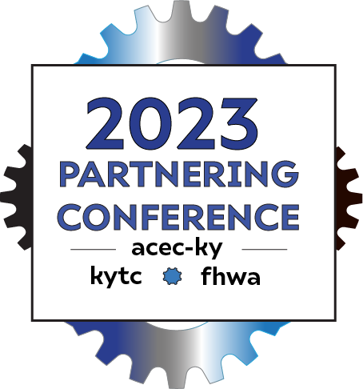
Ky 44 programming study
KYTC District 5
Speakers:
Tracy Lovell, PE D5 Project Development Branch Mgr
Zachary Neihof, PE, RSP1 TSMO Program Lead
Doug Smith, PE WSP Project Manager
Notes:
TRACY

Slide 2
CORE Project team
KYTC
Consultant team
Tom Hall (D5 PM)
Beth Neiman (C.O. PM)
Zach Neihof (D5 Traffic)
Tracy Lovell (D5 Project Devel.)
Larry Chaney (D5 Planning)
Stephen DeWitte (C.O. Planning)
Anne Warnick (WSP SW Planning Mgr)
Doug Smith (WSP L.A. PM)
Chris Barrow (WSP TSMO)
Billy Garrison (WSP Roadway)
Austin Obenauf (WSP)
Elizabeth Farc (WSP)
Cameron Manley (WSP)
Rob Frazier (HDR)
Travis Thompson (HDR)
Philip Bischof (HDR)
Sam Wiser (TSW)
Notes:
TRACY

Slide 3
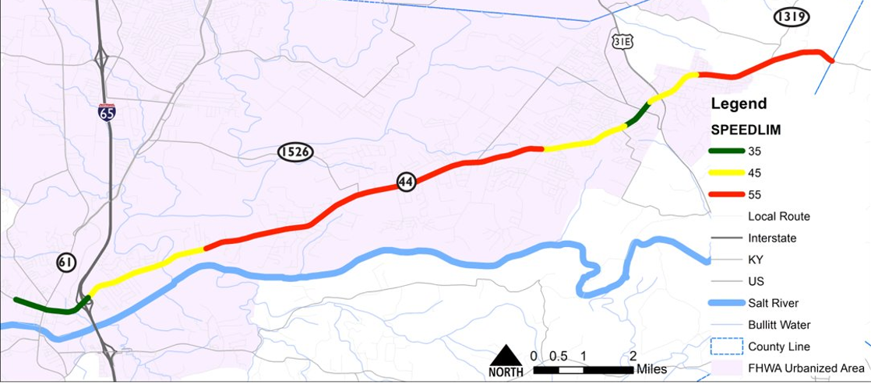
the project
“Review existing projects to optimize performance.”
~14 miles of KY 44 in Bullitt Co.
Notes:
TRACY –
Validating design assumptions
Identifying TSMO and PBFS solutions
Developing a project priority programming scheme
Investigate proposed developments & evaluate their effect
Forecast the potential traffic
Explore network connections’ ability to help KY 44
The improvement concepts will be evaluated and prioritized based on criteria developed by the project team
Write a technical report

Slide 4
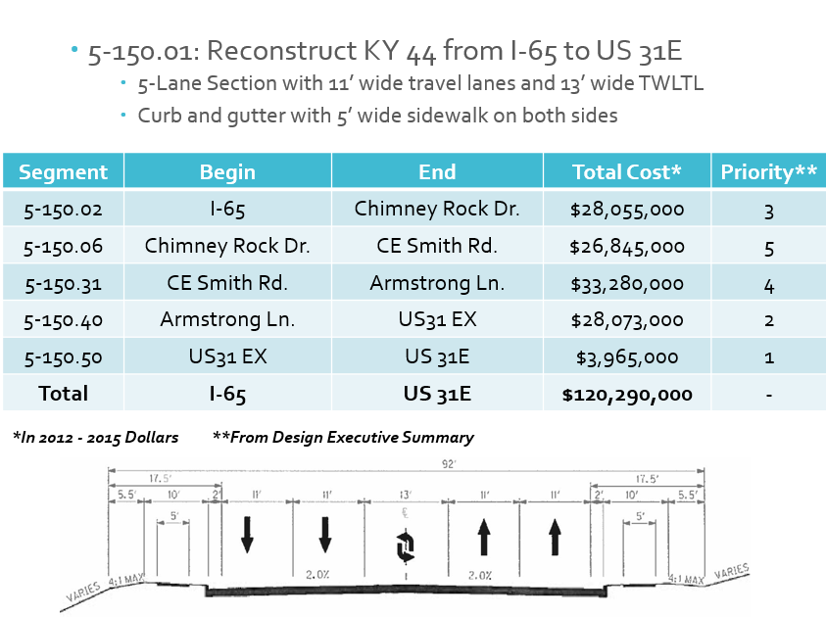
WhaT led to the study?
2005 Bullitt County Item 05-150.00 Study
2022 Dollars:
$132,000,000
Notes:
TRACY – 2005 Study
Reconstruct KY 44 between I-65 and US 31E
5-lane urban typical with sidewalks (no bike facilities)
Recognized that it needed to be broken in segments and prioritized for funding
Essentially prioritized the ends and then the middle
Subsequent minor turn lane improvements were completed following this study

Slide 5
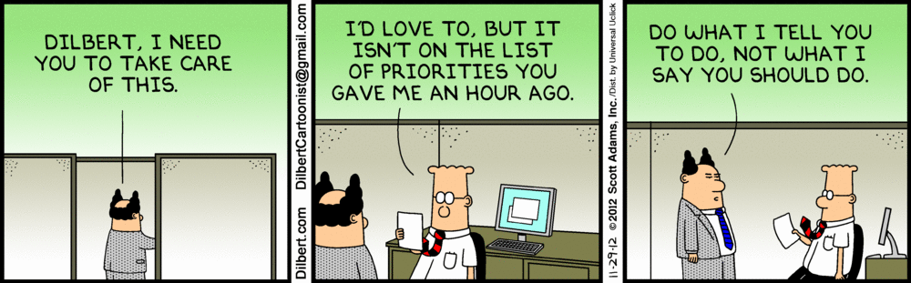
What led to the study?
Notes:
TRACY – Every good Engineering presentation has a Dilbert Cartoon

Slide 6
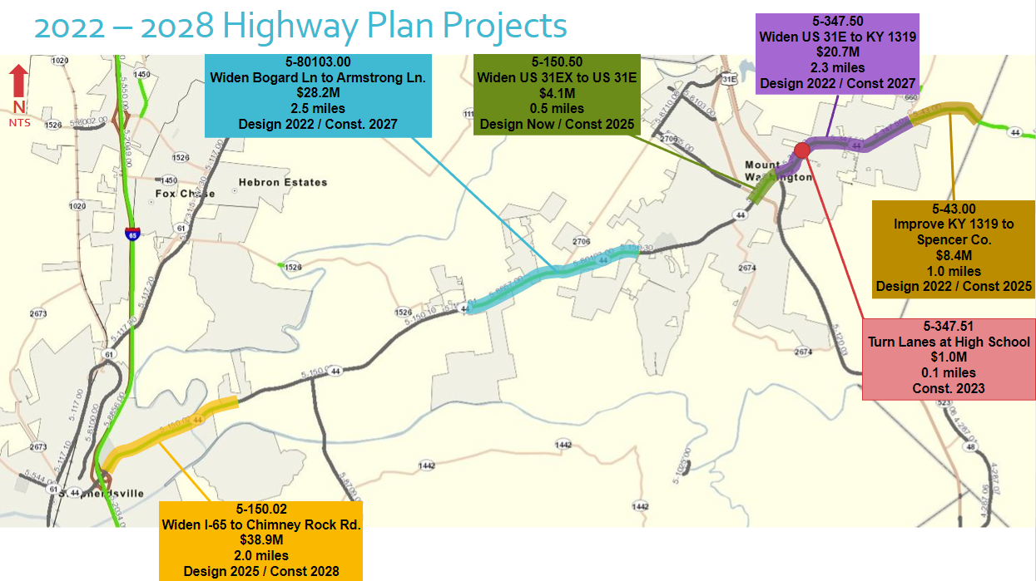
What led to the study?
Under Dsn
Notes:
TRACY
2012 Study (5-396) covered US 31E into Spencer Co.
Project 5-347.50 and 5-43 within limits of that study
Kinda held to the Prioritization of 5-150 study in the ‘22 SYP
New project (5-80103) combined parts of two segments (Priorities 4 and 5)
Add 5-43 (which is the bastard piece of the Bullitt County-funded 5-347.10 project)
School turn lane project for good measure

Slide 7
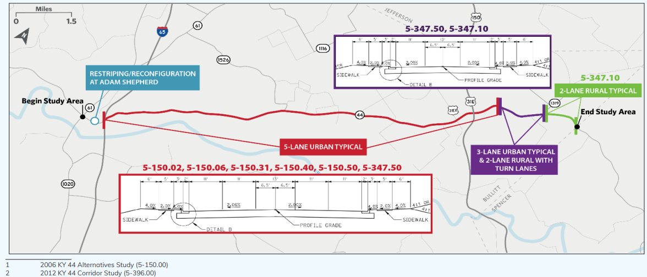
What led to the study?
needed to step back and look at
how the corridor operated at the system level
Notes:
TRACY
Recommendation (between the two studies) was 5-lane the majority, transition to 3-lane urban, then rural 2-lane (with turn lanes) for the remaining segments
Projects Competing For Funding
Challenges To Addressing Capacity In The Near Term
Solving Spot Issues, But Not Whole-corridor Mobility
How should this corridor function in various segments?
Way of doing things changed in nearly 20 years?

Slide 8
Performance Based Flexible Solutions (PBFS) - “A flexible design approach that establishes design criteria based on project specific conditions and also on existing and future roadway performance is encouraged. Projects should be developed at the minimum impact and cost that will satisfy the goals, purpose, and need. “ (2022 KYTC Highway Design Guidance Manual)
Transportation Systems, Management & Operations (TSMO) “…a set of integrated strategies to optimize the performance of operations on existing infrastructure through implementation of multimodal, cross-jurisdictional systems, services, and projects designed to preserve capacity and improve security, safety, and reliability of a transportation system. In simplest terms, TSMO is a way to address reliability, mobility, and congestion by utilizing strategies rather than only building out of congestion.”. (FHWA)
PBFS
TSMO
Notes:
ZACH

Slide 9
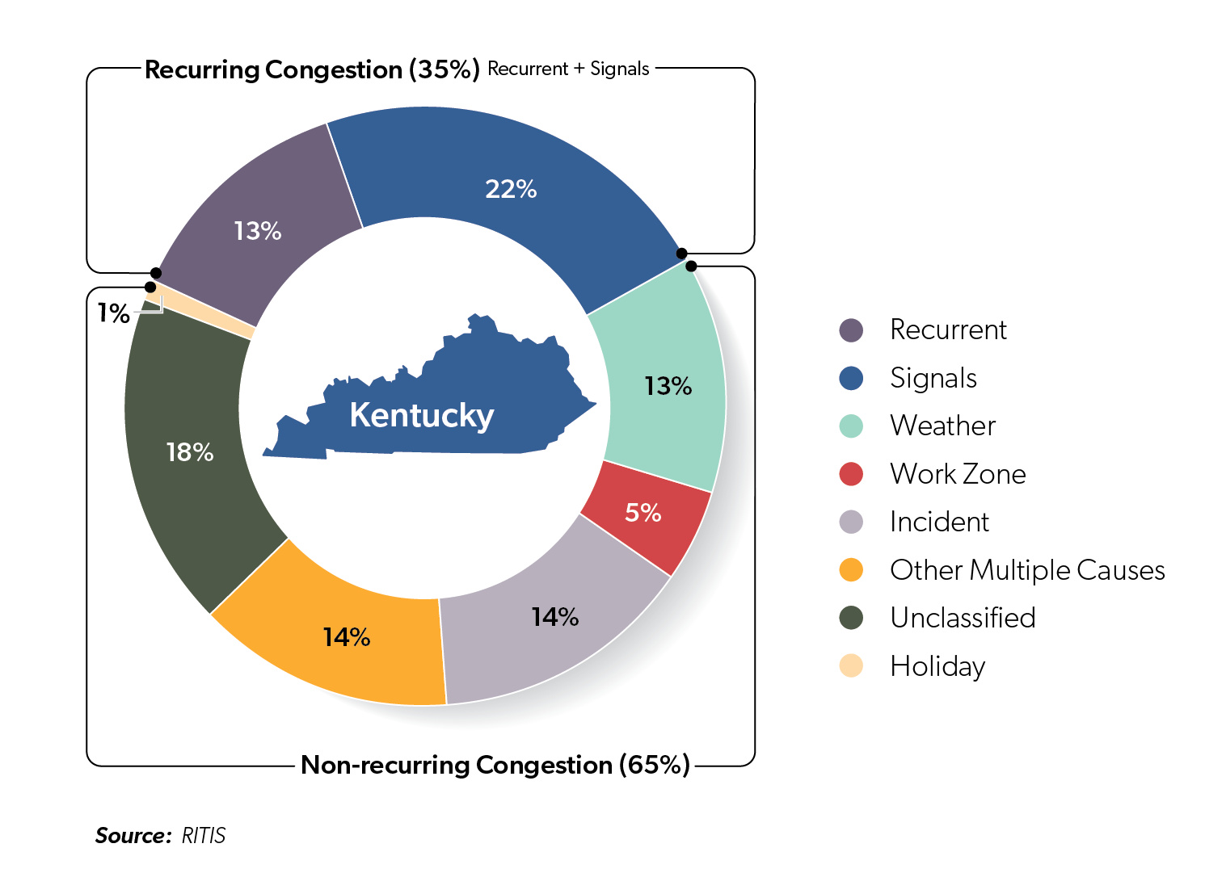
Why TSMO?
Launched by FHWA in 2012
Kentucky’s Congestion Chart
Identify operational needs
Desire for greater system safety, reliability and efficiency
TIM (Traffic Incident Management) in areas with limited alternative routes
Traffic Signal Retiming reduces delay between 15%-40%
Notes:
ZACK

Slide 10
KY 44 from a user’s perspective….
How traffic conditions have
been communicated
What travelers experienced
What drivers
remember
Travel
time
Annual average
Travel
time
Travel times vary
greatly day-to-day
Jan
Jul
Dec
Jan
Jul
Dec
Source: FHWA
Notes:
ZACK

Slide 11
Early phases of the work
TEAM MEETINGs 1 & 2
Notes:
DOUG – EXISTING CONDITIONS AND INITIAL ATTEMPT AT ANALYSIS

Slide 12
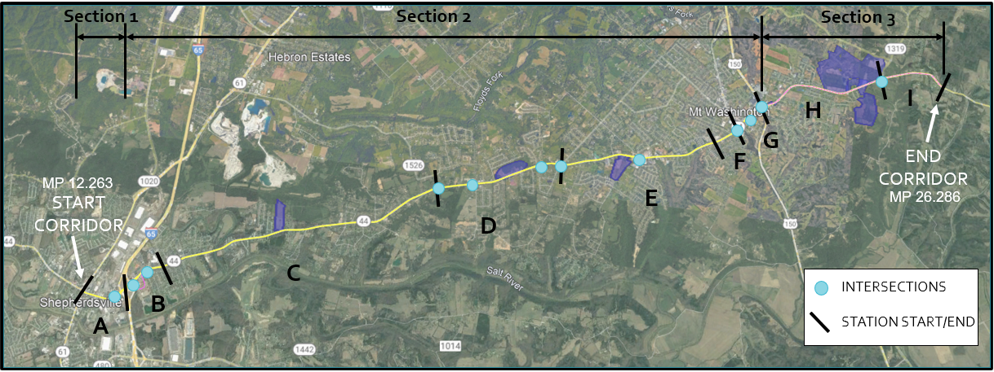
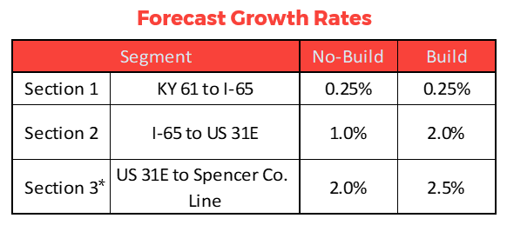
Corridor haS different growth rates, mixed rural and urban sections
Notes:
DOUG- The corridor’s CHARACTER, when you drive it, is FULL of community - schools, businesses, residences – 5 LANES WOULD REALLY CHANGE THAT

Slide 13
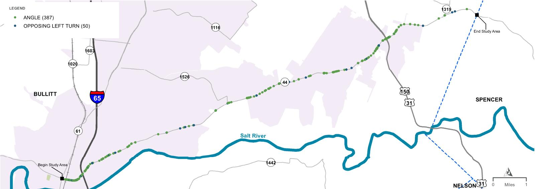
High # of Angle and Opposing Left Turn Crashes
Notes:
DOUG – 2 LANE FOR MOST OF LENGTH

Slide 14
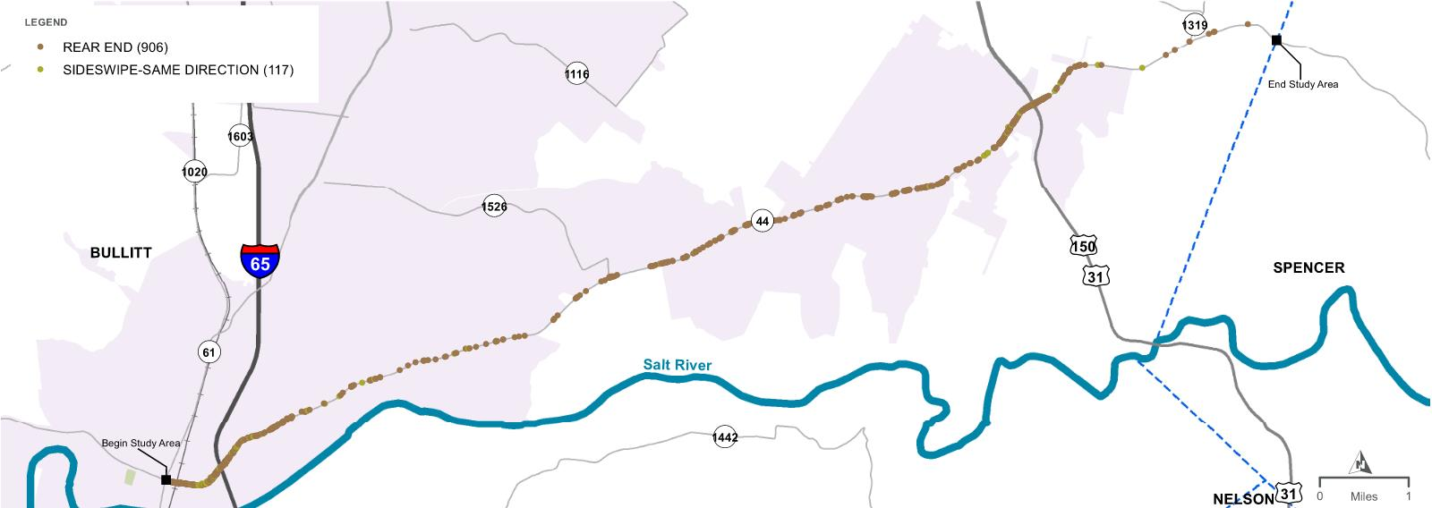
HIGH # OF REAR END AND SIDESWIPE-SAME DIRECTION CRASHES
Notes:
DOUG – 2 LANE, LOTS OF SPEED VARIATIONS

Slide 15
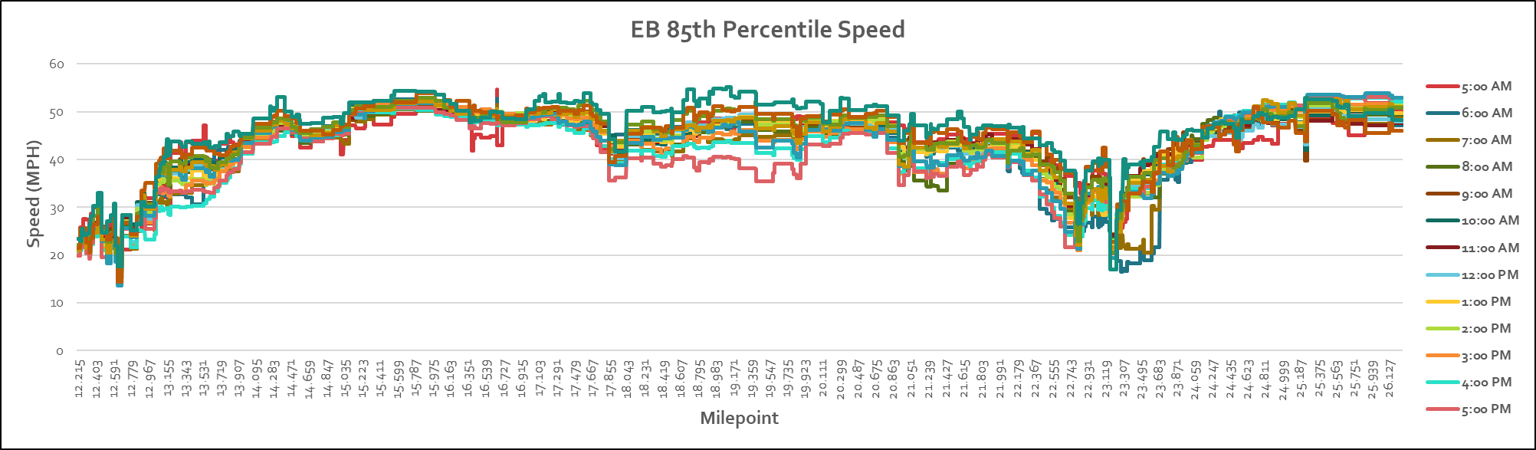
Existing SpeeDs
Notes:
DOUG

Slide 16
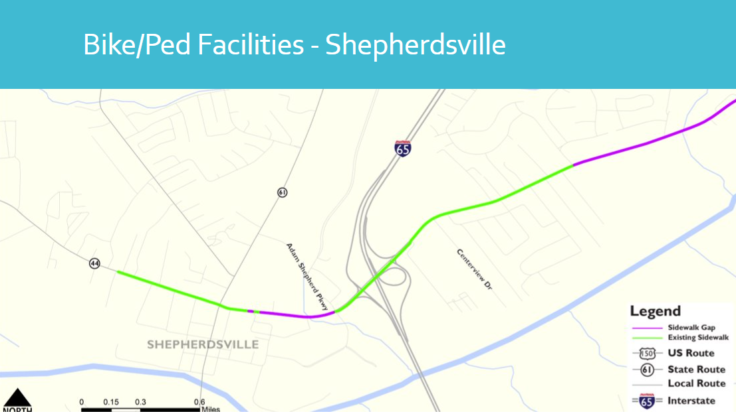
Complete streets
Notes:
DOUG - KYTC GUIDANCE WAS JUST RELEASED

Slide 17
Systems management approach
Getting drivers out of or around Mt. Washington improves mobility.
How much can the signals in Shepherdsville and Mt. Washington be improved?
Moving drivers more dependably through KY 44 to I-65 helps a great deal, however it is done.
Projected growth rate for KY 44 might be lower if network is improved.
Less lanes means less latent demand.
Need better OPERATIONAL diagnostics.
Notes:
DOUG - CHRIS BARROW ATTENDED PTM 2 – ANNE WAS ON MATERNITY LEAVE & DOUG NEEDED HELP!

Slide 18
HCS: When do segments fail in the future?
→ Our initial modeling/segments didn’t look closely enough at the dense urban areas & intersections
Notes:
DOUG - TO TRY AND SEE AN ORDER TO PRIORITIZE, WE MODELLED EVERY 5 YEARS OUT TO 2045 – THEY DID NOT VARY ALL THAT MUCH (SEE GROWTH RATES)

Slide 19
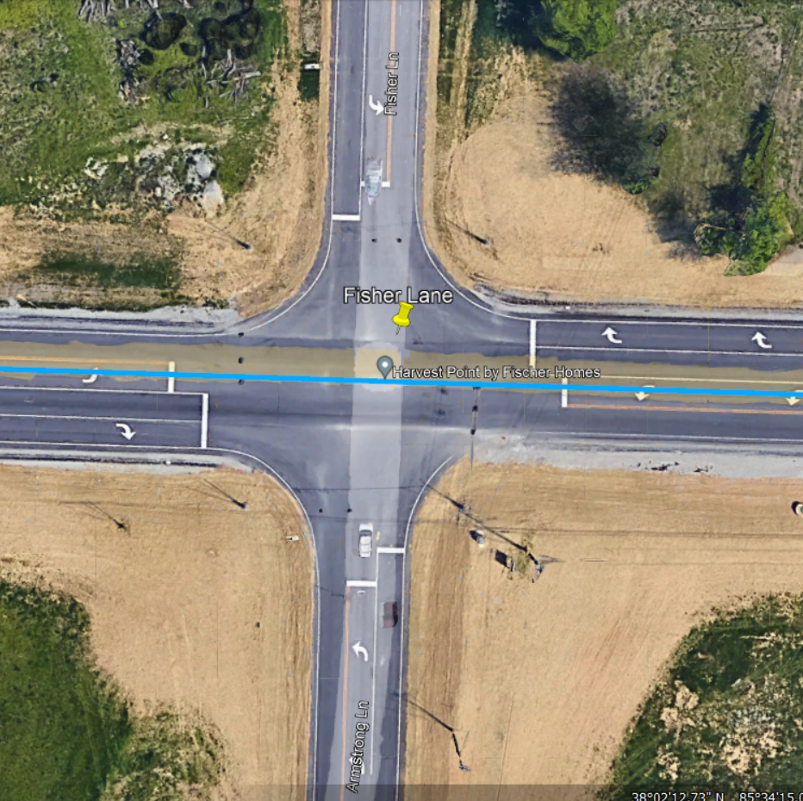
intersection failures:
KY 44 @ Fisher Ln/Armstrong Ln
Notes:
DOUG – LOOKED AT INTERSECTIONS WITH SYNCHRO AS WELL – INITIALY ONLY OVERALL LOS - BUT LATER WITH ALL DIRECTIONS – THE OPERATIONS ASPECT STARTED TO EMERGE! One or Two legs would fail, which affected KY 44 OVERALL performance

Slide 20
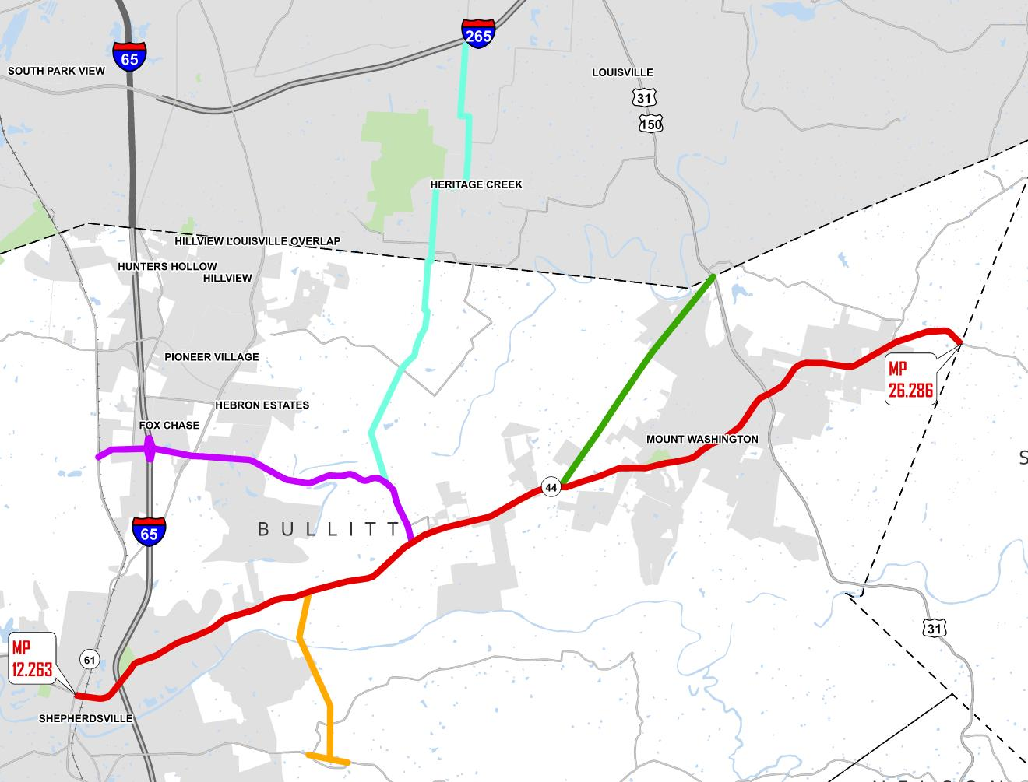
Network Connections Modeled
Study Area
N
Notes:
HDR ALSO LOOKED AT MAJOR CONNECTORS TO SEE IF THEY COULD BE IMPROVED. – THE ‘WASHINGTON BYPASS’ WOULD HAVE BEEN GREAT BUT THERE WERE ‘show stopper’ ROW ISSUES

Slide 21
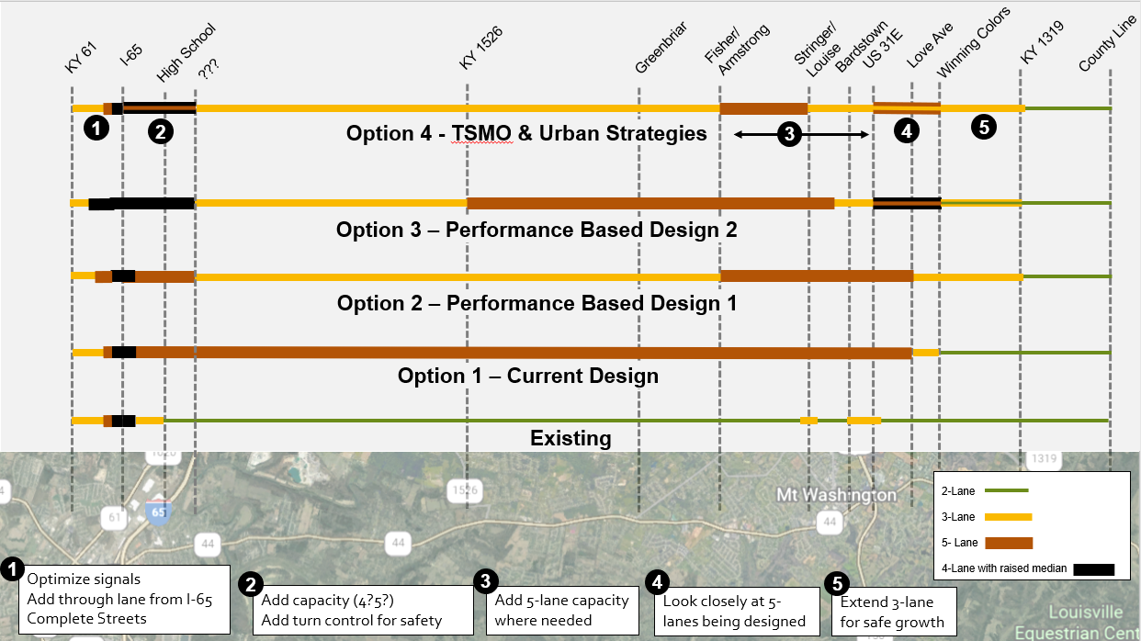
Notes:
OUR INITIAL CONCEPTS
PBFS was pretty easy once we realized 3 lanes helped a lot. SEGMENT LOS
Safety analysis was important and drove some of the options on cross-sections (3 lane or 4 lane from KY 1526 to Fisher/Armstrong – had several high speed crashes)
Urban cross sections had 4 lane, some 3 lane, even had a 5 lane option to test safety & LOS

Slide 22
And then it started to come together
Balancing LOS and safety was central, AND…
1
Signal upgrades for better design data - “Don’t model it when you can measure it.”
2
TSMO changed from an add-on to a Project Driver
3
Urban Strategies/Complete Streets required will require coordination
Notes:
DOUG – WANT TO ASK TRACY DURING PRESENTATION - CURIOUS WHAT HE WAS THINKING AT THIS STAGE ABOUT THE APPROACH

Slide 23
More findings
4
A 3-lane cross-section added a lot of Operational Benefit
5
Stakeholder education and buy-in will be key
6
This ‘high-level study’ became a data-driven, micro-level corridor performance analysis
Notes:
DOUG

Slide 24
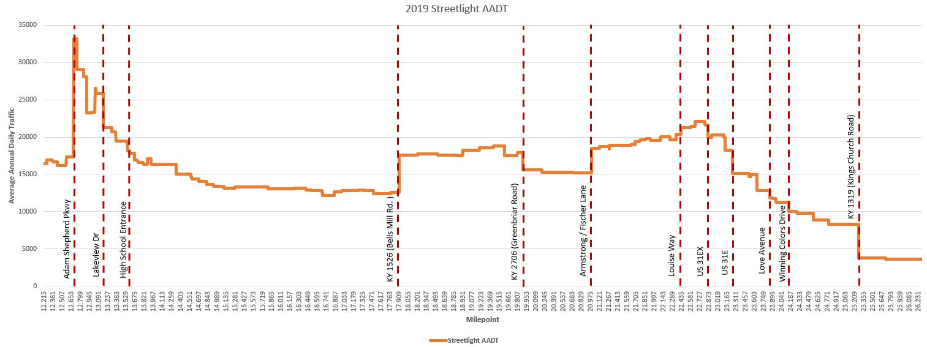
Traffic volume vs LOS
Notes:
STRONG EVIDENCE OF THE NEED FOR A VARIETY OF SOLUTIONS
Congestion at Shepherdsville and Mt Washington

Slide 25
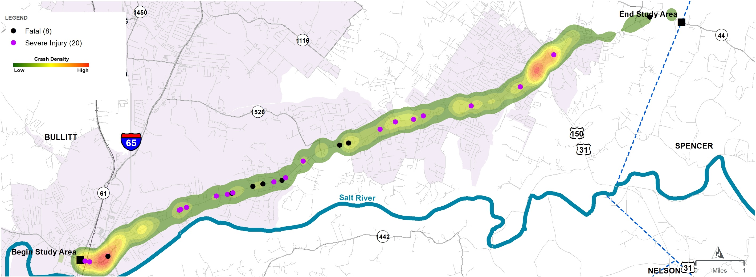
Crash density 2017-2021
Notes:
CRASHES
Urban Areas are very dense with crashes, but center of corridor is higher speed – so more critical (K & A) crashes.

Slide 26
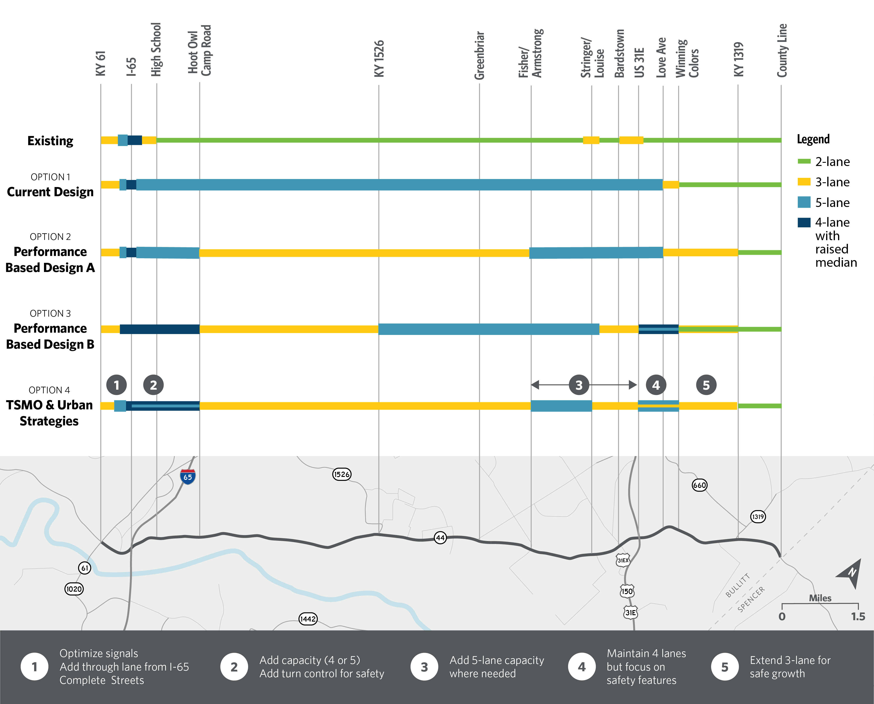
Right of Way Impacts
29 acres, $16.2M
20 building takes
20 acres, $11.9M
17 building takes
24.7 acres, $13.7M,
15 building takes
15.1 acres, $6.9M
7 building takes
ROW, especially in the cities, is expensive, and WON’T RESULT IN BETTER LOS
Notes:
5 LANES REQUIRES A LOT OF ROW – 16M, but also in the downtown areas (community impact)
TSMO APPROACH, Which would rely more on improved signals, will be a trade off of COSTS vs Level of Service – But LOS will only get so good even with 5 lanes
A GOOD STAKEHOLDER MOMENT!

Slide 27
Travel Time Reductions in 2045
Eastbound Westbound
- -
7-18% 6-14%
4-6% 4-8%
3-8% 6-8%
1-2% 1-5%
Notes:
SPEEDS WERE ALREADY HIGH.
“FULL CORRIDOR” TSMO CONCEPT DID NOT PERFORM AS WELL AS HOPED – but certain areas like intersections DID work better
BUT an 18% time reduction over 14 miles at an average 50 MPH is only a 3 minute savings.
5% is only 50 seconds time savings
Relief at MAJOR congestion spots, more continuous flow (intersections) , and safer travel may be just as valuable to users

Slide 28
Cost Estimates
$132,000,000
$115,000,000
$124,000,000
$107,000,000
Notes:
ORIGINAL DESIGN – did not include work west of I-65 or EAST of Winning Colors

Slide 29

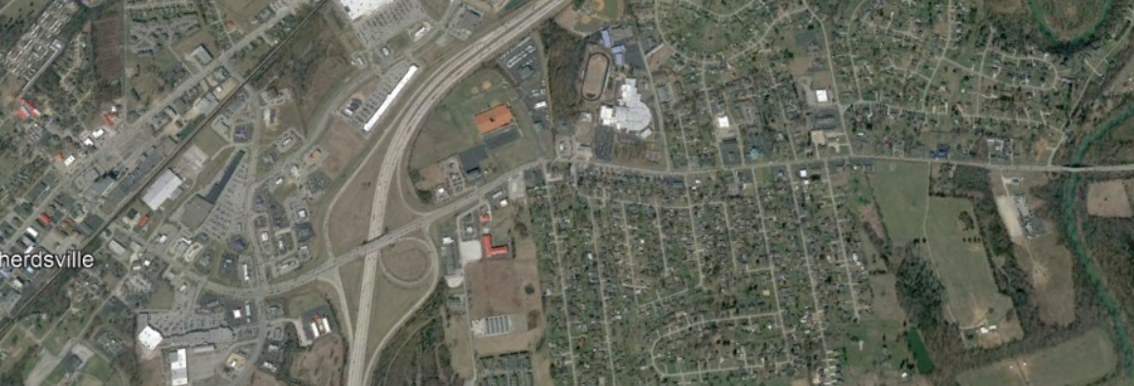
URBAN STRATEGIES - SHEPHERDSVILLE
Key Issues | Upgrades to Consider
Congestion & Queueing | Upgrade & optimize traffic signals * Add lanes between I-65 & Adam Shepherd Pkwy 4 or 5 lanes east to Hoot Owl Camp Road
High Crash Rates | Utilize raised median 4-lane cross-section Access management to reduce driveway entrances
Expensive ROW | Optimize existing pavement/lanes *
Pedestrian Vulnerability | Add sidewalks, curbs, crosswalk visibility
(* = short-term improvements)
Notes:
More, and multimodal, issues in urban areas that widening would not fully address.

Slide 30
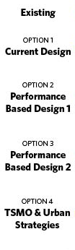
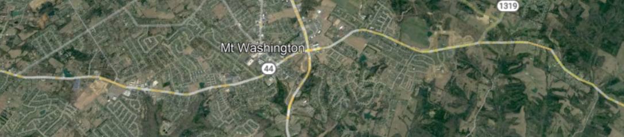
URBAN STRATEGIES - MT. WASHINGTON
Key Issues | Upgrades to Consider
Expensive ROW | Optimize existing pavement/lanes
High Crash Rates | Utilize raised median 4-lane cross-section Limit left turns Access management around US 31E intersection
Congestion & Queueing | Upgrade & optimize traffic signals * 5-lane cross section where needed Complete downtown grid segments Potential network connection/northwest bypass Potential roundabout at KY 1319 (Kings Church Rd) Reserve ROW east of US 31E for future growth
Pedestrian Vulnerability | Add/complete sidewalks, crosswalks, curbs
(* = short-term improvements)
Notes:
Cross sections and smooth traffic operations required lots of thought. Detailed counts would have helped, but that is for the next engineer!

Slide 31
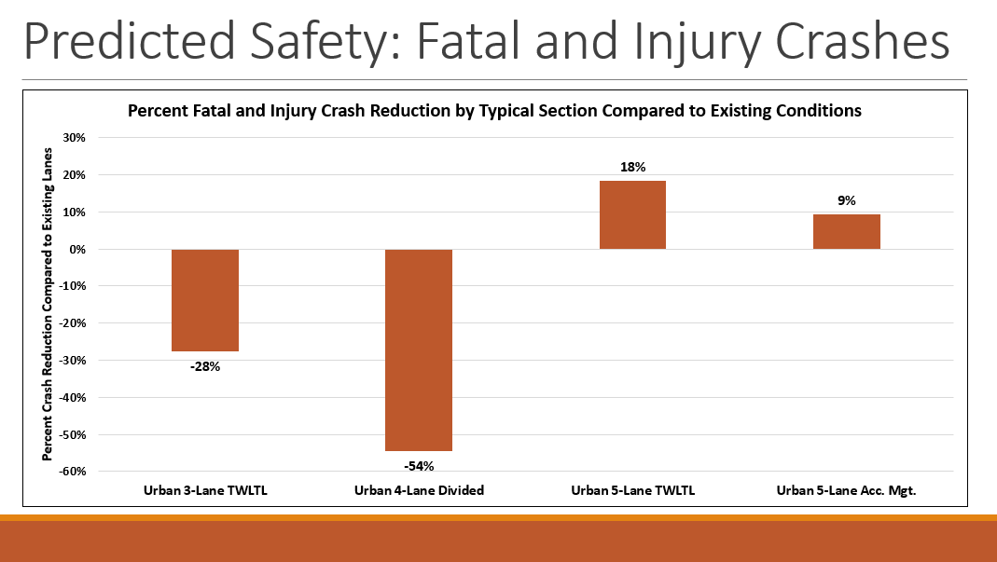
Stakeholder input
Notes:
Even for the Project Team, this generic comparison of cross-section safety was a helpful reminder
Its seemed to really ‘stick’ with the Stakeholders

Slide 32
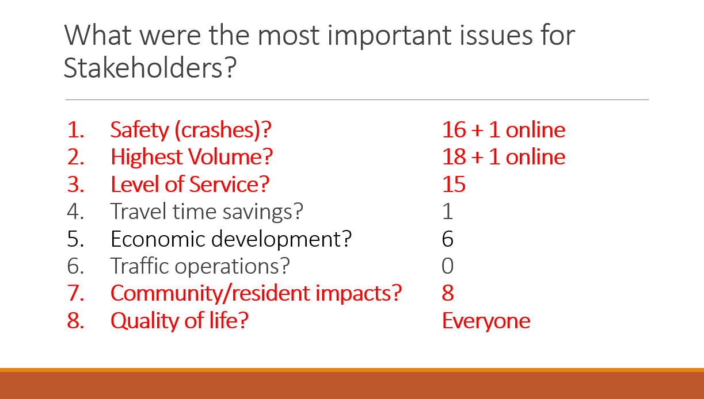
Stakeholder input
Notes:
Balancing safety and mobility is not an uncommon theme, but COMMUNITY AND QUALITY OF LIFE were surprising

Slide 33
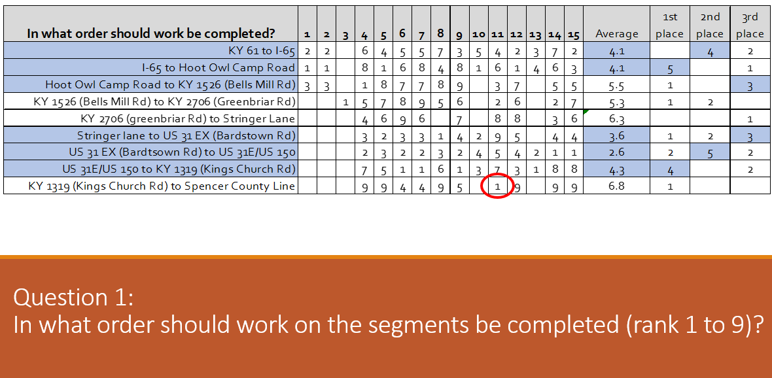
Stakeholder input
Notes:
These votes were aggregated to get a sense of priority – it showed focus was more towards the cities where there was congestion/low LOS
The standout singular vote was a strong stakeholder

Slide 34
SORTING OUT THE PROGRAM:
Prioritization & timing
Traffic and safety analyses
Right-of-way impacts
Overall cost
Travel times
Existing and new network connections
Input from stakeholders
Notes:
At a high level, these were the aspects that would guide our prioritization, but the intertwining of segments & intersections, and optimal timing of each required a closer look

Slide 35
SORTING OUT THE PROGRAM:
Prioritization & timing – look deeper
LOS - Intersections
LOS - SEGMENTS
Current LOS level
Degree of LOS Improvement 2045
Importance to adjacent segments
Ability to expand capacity
Current LOS level
Degree of LOS Improvement 2045
Importance to adjacent segments
Ability to expand capacity
SIGNALIZATION
SAFETY
Planned signal or upgrade?
Importance to network?
Initial level of K&A crashes
Change in K&A crashes
COST
STAKEHOLDERS
Planned signal or upgrade?
Importance to network?
High network impact per $
Reasonable cost per segment
Strong current support?
Makes engineering sense?
Tied with adjacent segments?
Notes:
Very focused evaluation across many metrics, connected to other segment, required the MOAS

Slide 36
MOAS – ‘MOTHER OF ALL SPREADSHEETS’
Notes:
MOTHER OF ALL SPREADSHEETS – A little like Multi-dimensional Chess on Star Trek!
We started to chart out where THE PROGRAM had been, and where our evaluation was guiding it – colored bars as bottom to start drafting the segment and intersections’ order

Slide 37
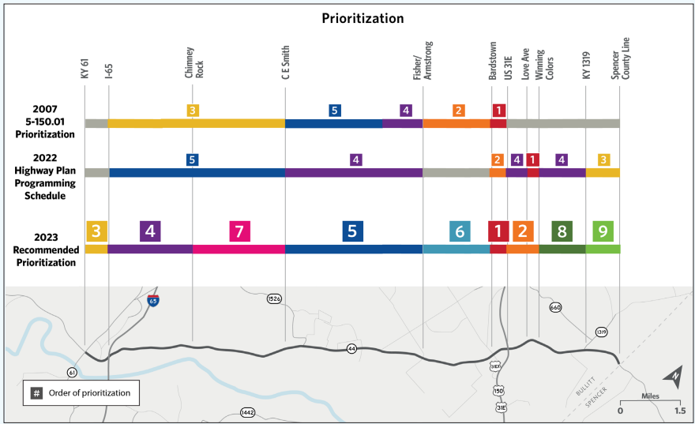
Notes:
GREY AREAS ARE those with NO CURRENT PLANNED KYTC PROJECTS
1st LINE – ORIGINAL STUDY
2nd LINE – 2022 ENACTED STATE HIGHWAY PLAN
3rd LINE – The Project Team’s Recommendation
Urban areas generally early
Then segments adjacent to urban areas, including signal and intersection upgrades to aid flow
Segment 5 is where the more high speed K&A crashes had happened

Slide 38
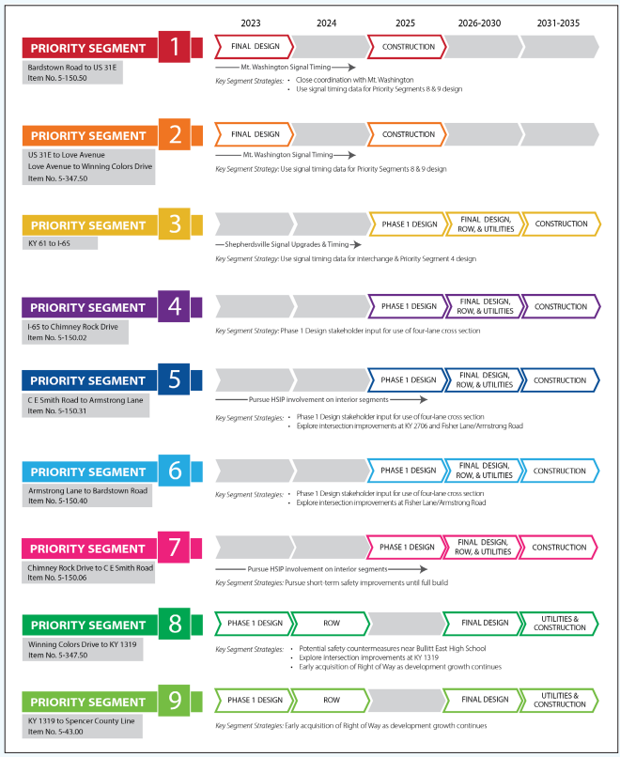
Notes:
HAD TO TRY TO MAKE IT WORK FOR A DISTRICT PROGRAM WITH FISCAL CONSTRAINTS
HAD TO RE-SIZE AND RE-GROUP SOME SEGMENTS BASED ON COST
HAD TO SHOW PROGRESS IN STAKEHOLDER-SUPPORTED SEGMENTS WHILE STILL RESPECTNG THE ENGINEERING RESULTS
SEGMENTS 8 & 9 are Burges & Niple
SEGMENT 1 is now under design
VERY HELPFUL IN THE SHIFT PROCESS
HOPEFULLY HELPFUL ENGAGING WITH THE CITIES’ ENGINEERS and STAKEHOLDERS

Slide 39
conclusions
Increasing capacity doesn’t always solve problems – and sometimes makes them worse
Assess the data sources and quality of projects up front
A corridor’s network connectivity impacts operations
TSMO is not ‘sometimes applicable’ – its very wholistic
There are benefits to having an overall corridor strategy if it is a varied, complex corridor with multiple issues

Slide 40
Thank you!
Contacts:
Tracy Lovell (D5), Tracy.Lovell@ky.gov
Tom Hall (D5), Tom.Hall@ky.gov
Elizabeth Niemann (Planning), Elizabeth.Niemann@ky.gov
Zach Neihof (TSMO), Zachary.Neihof@ky.gov
Doug Smith (WSP), Douglas.Smith@wsp.com

